Slide 1


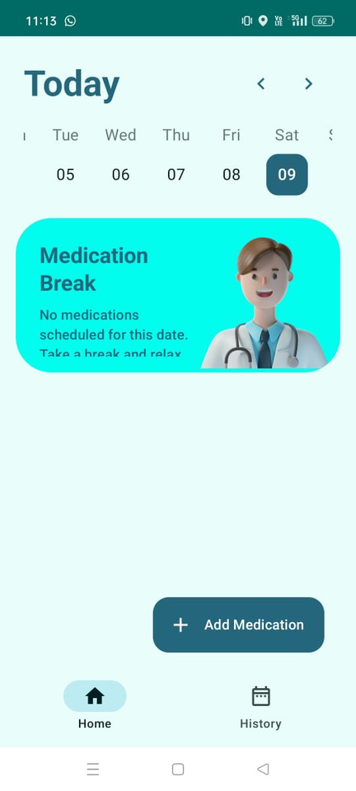
Medicine Reminder Using Android Studio
Team Members:
210701092 - Jeffrey Jesudasan R
210701099 - Jothiprasad D
210701090 - Jeeva Bharathi K

Slide 2

Abstract:
Development of an Android Studio application for medication reminders, aimed at enhancing medication adherence through timely notifications and user-friendly interfaces.
Goal of the Medicine Reminder app: to provide consumers with a straightforward solution for managing their prescription schedules.
Features include the ability for users to input medication details such as name, dosage, frequency, and administration times.
Utilization of Android's notification system to send users reminders at specified times, ensuring adherence to prescribed medication regimens.

Slide 3
Introduction:
Adherence to prescribed medication regimens is essential for effective healthcare management but remains challenging, leading to adverse outcomes and increased costs.
Factors contributing to non-adherence include forgetfulness, complex medication schedules, and lack of understanding about the importance of consistent medication intake.
Mobile applications offer innovative solutions to address medication non-adherence due to their accessibility and user-friendly interfaces.
This project focuses on developing a Medicine Reminder application using Android Studio to enhance medication adherence through timely notifications and user-centric design.
The app allows users to input and manage medication schedules, leveraging Android's notification system to send reminders at specified times.
Future developments may include advanced features such as synchronization with wearable devices, AI-based adherence predictions, and integration with healthcare provider systems, further improving its impact on health outcomes and cost reduction.

Slide 4

Literature review
[1] In their comprehensive review, Brown and Bussell (2011) highlight the critical issue of medication non-adherence, emphasizing its impact on patient health and healthcare costs. They discuss various factors contributing to non-adherence, such as complex medication regimens and side effects, and call for increased attention to adherence strategies in clinical practice. Their work underscores the importance of developing effective interventions to improve medication adherence and ultimately patient outcomes.
[2] Nieuwlaat et al. (2014) conducted a systematic review of interventions designed to enhance medication adherence. They found that interventions combining multiple approaches, such as patient education, reminders, and support, were more effective than single-strategy interventions. Their findings suggest that a multifaceted approach is crucial for significantly improving medication adherence, which has important implications for designing adherence programs and technologies.

Slide 5
[3] Free et al. (2013) performed a meta-analysis to evaluate the effectiveness of mobile health (mHealth) technologies in improving healthcare delivery. They concluded that mHealth technologies, particularly mobile applications, significantly enhance patient engagement and health outcomes. Their study supports the potential of mobile apps to provide timely reminders and educational resources, thus improving medication adherence and patient management.
[4] Morrissey et al. (2018) explored patient perspectives on smartphone apps for managing hypertension medication. They found that users valued the convenience and accessibility of apps, which helped them adhere to their medication schedules. The study highlighted the importance of user-friendly design and customization options in mHealth applications to meet individual patient needs and preferences

Slide 6
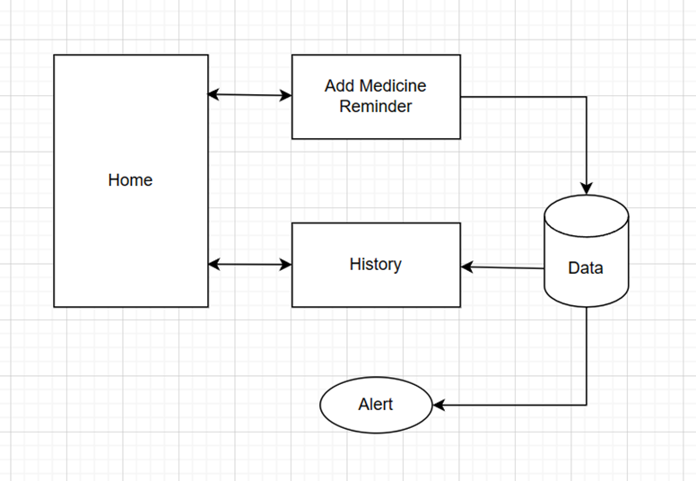
Architecture Diagram

Slide 7
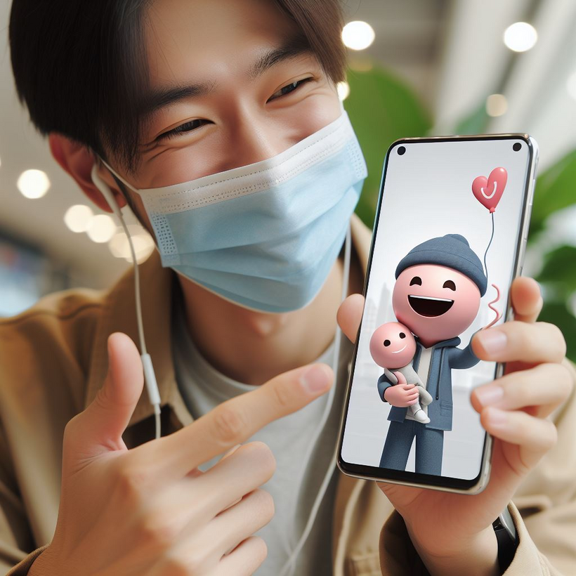

Applications Used
Android Studio
Kotlin
MySQL
For Making Android Application UI
For Making the Android Application Functional
For Storing the Medicine Reminders

Slide 8
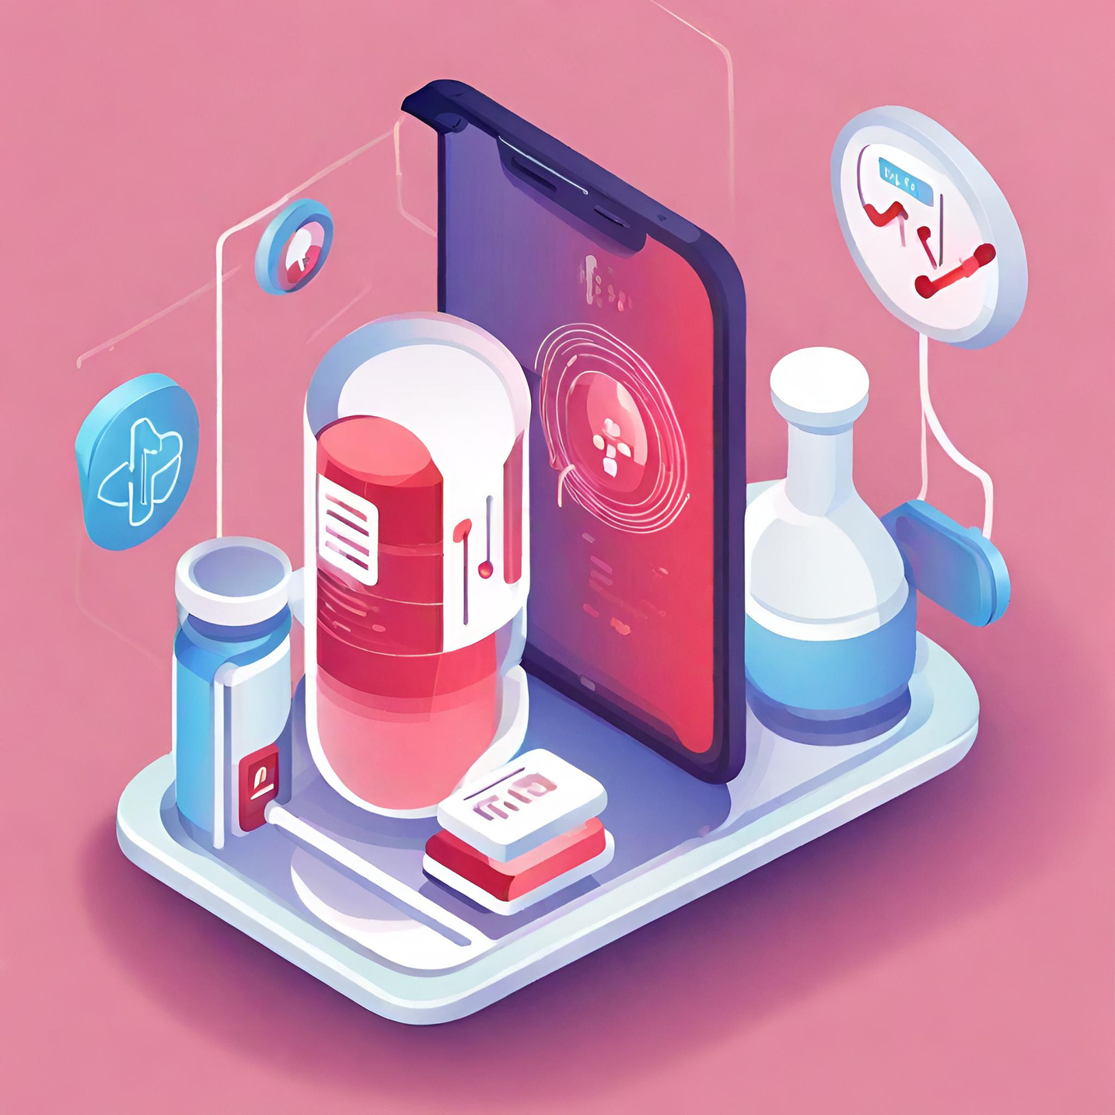
Modules
Home Interface
Add Medicine Reminder Page
View and Manage Medicine Reminder Page

Slide 9
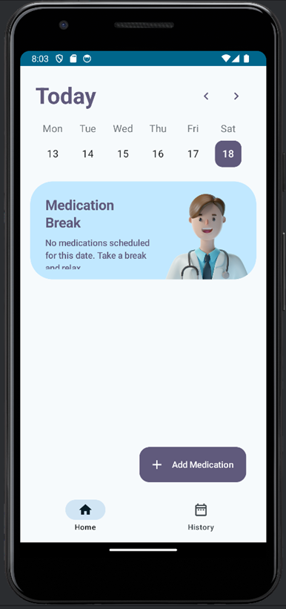
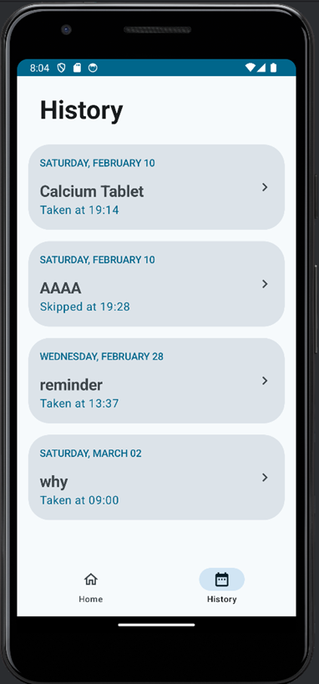
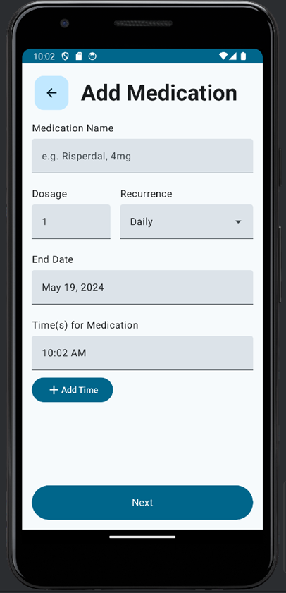
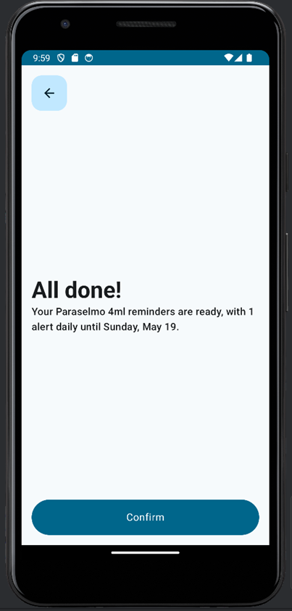
Result and Output

Slide 10
Conclusion
Our medicine reminder application addresses the critical need for improved medication adherence with its user-friendly interface and customizable features.
By providing timely reminders, it empowers individuals to take control of their health and achieve better treatment outcomes.
The application enhances treatment efficacy by ensuring medications are taken as prescribed, promoting overall health and reducing healthcare costs.

Slide 11
Reference
[1]Brown, M. T., & Bussell, J. K. (2011). Medication adherence: WHO cares? Mayo Clinic Proceedings, 86(4), 304-314. https://doi.org/10.4065/mcp.2010.0575
[2]Nieuwlaat, R., Wilczynski, N., Navarro, T., Hobson, N., Jeffery, R., Keepanasseril, Haynes, R. B. (2014). Interventions for enhancing medication adherence. Cochrane Database of Systematic Reviews, (11). https://doi.org/10.1002/14651858.CD000011.pub4
[3]c Free, C., Phillips, G., Watson, L., Galli, L., Felix, L., Edwards, P., ... & Haines, A. (2013). The effectiveness of mobile-health technologies to improve health care PLoS Medicine, 10(1), e1001363. https://doi.org/10.1371/journal.pmed.1001363
[4]Morrissey, E. C., Casey, M., Glynn, L. G., Walsh, J. C., & Molloy, G. J. (2018). Smartphone apps for improving medication adherence in hypertension: patients’ perspectives. Patient Preference and Adherence, 12, 813-822. https://doi.org/10.2147/PPA.S144047

Slide 12
THANK YOU

